Slide 2
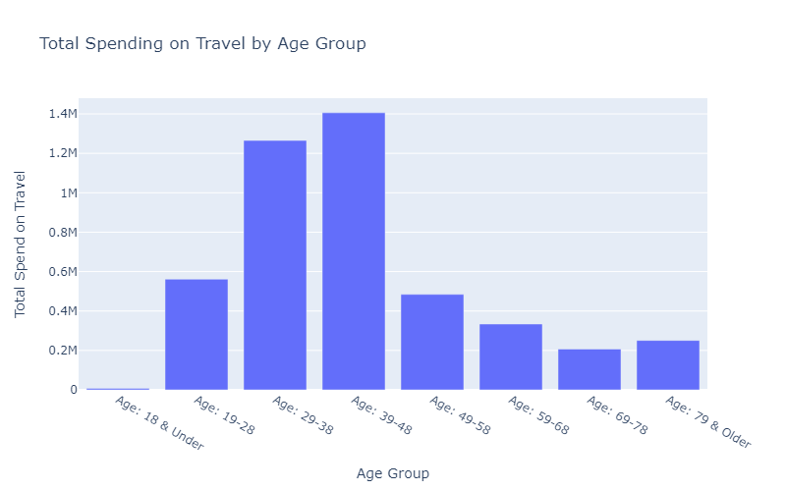
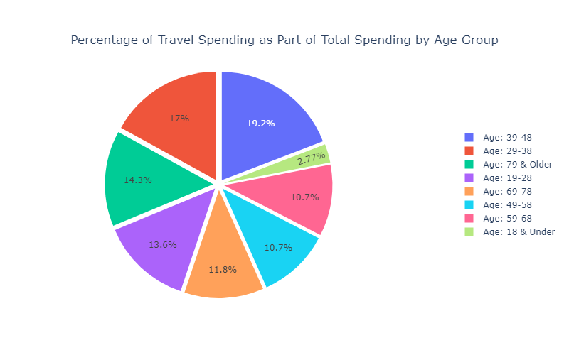
Travel Spend Opportunities
Target Ages : 49-58, 58-68, 69-78
Tailored Reward Points Incentives: 3X points on travel spend
Complimentary Travel Insurance
Family Bonus : 3+ more airline ticket purchases – 5000 points
Health and Wellness Travel Perks : Partner with Spa Resorts, Health Retreats, Medical Travel

Slide 3
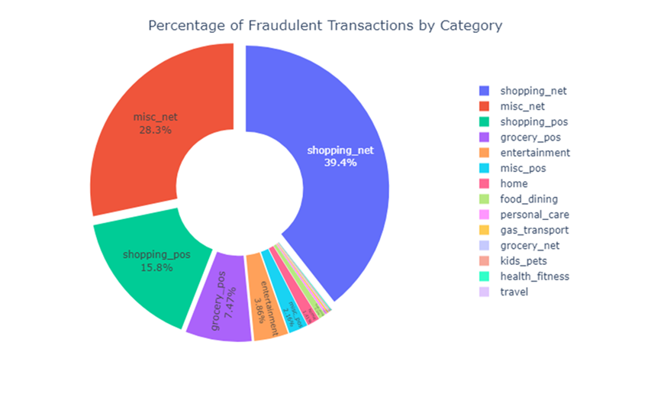
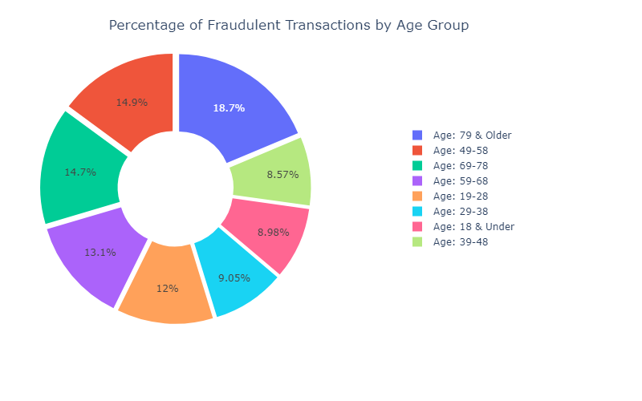
Fraud Among the Ages
Target Ages and Categories: 79 & Older – 67.7% Fraud transactions online shopping (misc_net, shopping_net
Increase security of online shopping
Dynamic MFA
Biometrics
Make OTP mandatory
Tokenization
AI “Smart Guard” – analyzing spending patterns in real time

